Slide 1
Texas Dept of Transportation Crash Data 2013
Lesson 10 Final

Slide 2
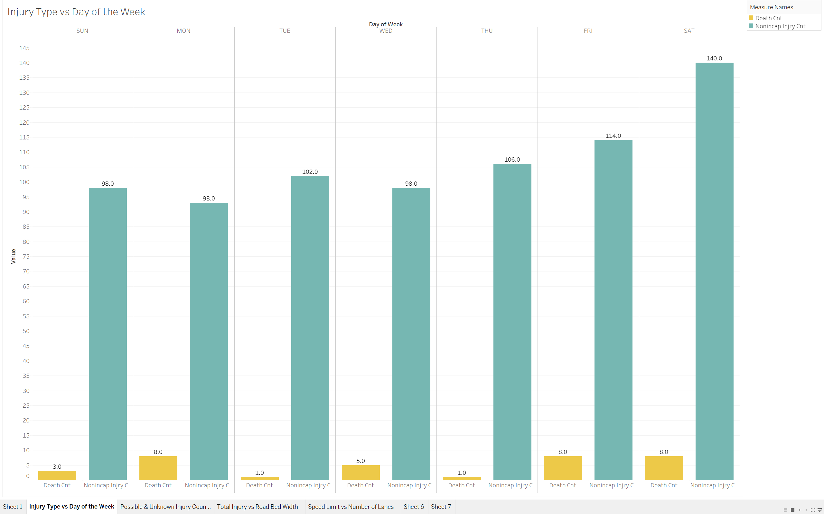
Injury Type by Day of the Week
Here we have the number of deaths next to number of non-incapacitated injuries, organized by day of the week.
Here we see that the non-incapacitated injuries increase on Thursday, Friday, and Saturday, respectively. This makes sense as the from Thursday on, there tends to be more “going out” and socializing which means there are more people on the road.
Interestingly, there are fewer deaths on Tuesday, Thursday, and Sunday.

Slide 3
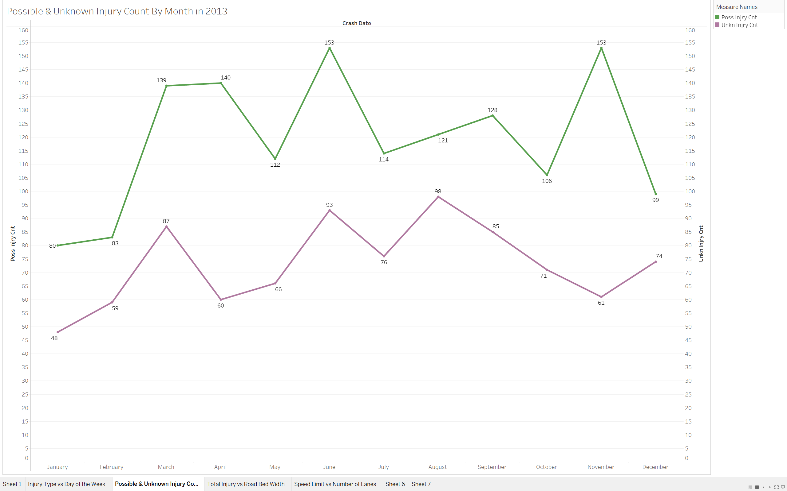
Possible and Unknown Injury by Month
Here we are comparing Possible Injuries versus Unknown Injuries, organized by month.
Here we see that January has the least amount of injuries; possibly due to weather, less drinking, partying, and more people “being good” for their resolutions.
There is a spike in injuries during June and another spike during November. November has a dip in unknown injuries while the possible injuries spikes.
December has the steepest decrease in possible injuries, likely a side effect of the steep increase from November injuries

Slide 4
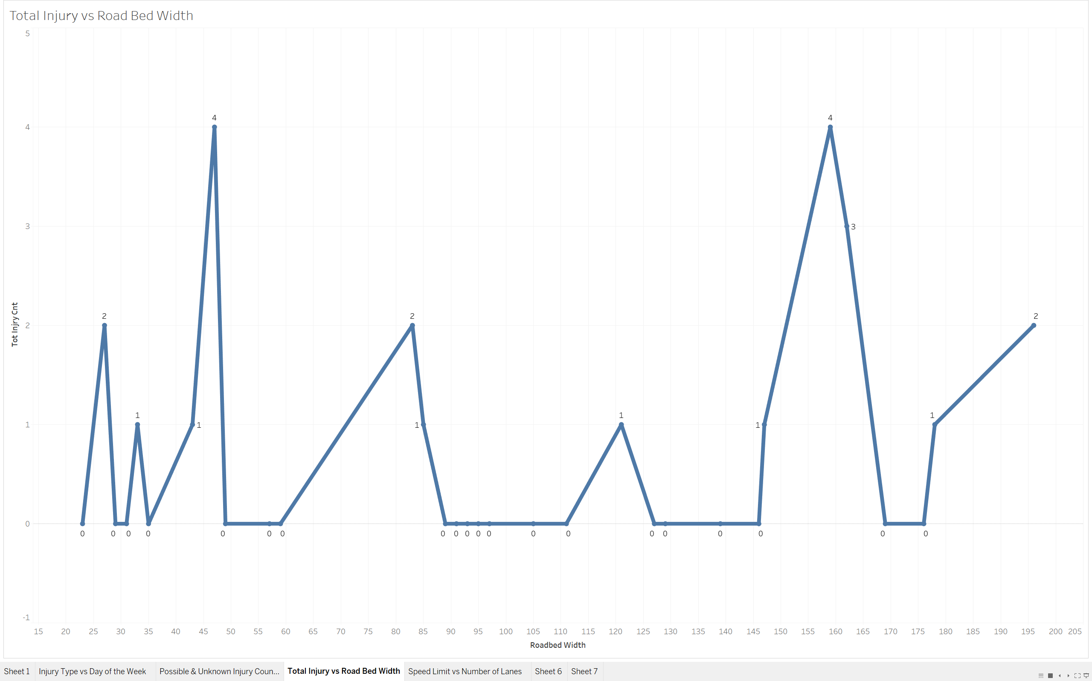
Total Injury Count vs Roadbed Width
Here we are looking at whether the width of the roadbed influences how many injuries occur during an accident.
There appears to be two spikes, in the 45 and 160 range. Inferring from the numbers it is possible that there are more accidents that lead to injuries on particularly smaller roadways and on particularly large roadways.
This makes sense as small roadways can be tight, cars are much closer to each other; very large roadways means there are more cars on the road, which can be a factor influencing more accidents.

Slide 5
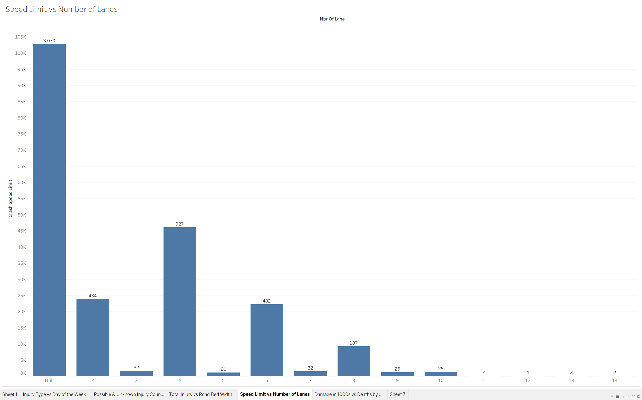
Speed Limit of Accidents vs Number of Lanes
What is most interesting about this graph is that there is a disproportionately large number of accidents that are in the null category. I am curious as to why that is.
Outside of this data, the 4 lane roads have the highest speed limits for accidents.
All the odd numbered roads have a very small, >40, crash speed limit. Possibly because drivers are used to even numbered lanes and drive slowly in odd numbered lanes.
Also, the roadways with the most lanes have the fewest accidents here

Slide 6
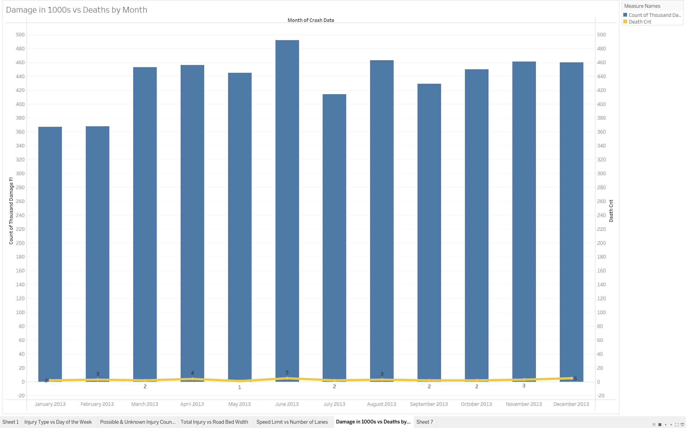
Damage in 1000s with Death Counts by Month
Here we see the cost of damage in the 1000s alongside the number of deaths, organized by month.
January and February have the lowest numbers in reference to Damage costs.
As we have seen before, June has the most accidents, the most deaths, and here the largest cost of accidents.
Thankfully, deaths by month remain low despite increasing costs of accidents.

